Slide 1

MAGPIE: A demonstration of symmetric encryption
Department of Computer Science and Engineering
BATCH - 2
GUIDE
HOD
Amulya Reddy Y -217Y1A0572
Srinivas Rao T -217Y1A05C0
Mr. T. S. Srinivas
Associate Professor
Dr . K. Abdul Basith

Slide 2
Index
ABSTRACT
OBJECTIVES
SYSTEM ARCHITECTURE
PROPOSED SYSTEM
OUTPUT
CONCLUSION
REFERENCES
3
4
5
6
7 - 9
10
11

Slide 3
Abstract
The project "Magpie" addresses this need by demonstrating encryption through a Python-based application. This project is important as it provides both a command-line interface (CLI) and a graphical user interface (GUI), making cryptographic principles accessible and interactive for users.
The primary objective of the Magpie project is to implement and demonstrate the fundamental principles of cryptography and information security. It later aims to offer Image encryption and decryption using a super key by implementing SHA-512. Magpie employs Python as the core programming language, integrating the cryptography library for implementing symmetric encryption using the hashing through SHA-256. The methodology involves key generation, encryption, decryption, and error handling to ensure secure and efficient processing of text messages.
The project is anticipated to effectively demonstrate the concepts of symmetric encryption and hashing, providing security and users with a practical understanding of cryptographic principles.
Magpie has the potential to significantly impact the educational domain by serving as a valuable learning tool for cryptography and information security. It simplifies complex cryptographic concepts, making them accessible to a broader audience.

Slide 4
Objectives
Key Management:
generate_key (): Generates a new symmetric encryption key and saves it to a file named ‘key.key’.
load_key (): Loads the encryption key from the ‘key.key’ file. If the file does not exist, it generates a new key.
Encryption: Encrypts a message using symmetric encryption with the provided key.
Decryption: Decrypts an encrypted message using the provided key. It handles potential errors such as invalid tokens or bin ascii errors.
Error Handling: The module handles errors such as missing key files and invalid tokens during decryption. It raises custom exceptions (`Key NotFoundError`) to notify users of key-related issues.

Slide 5
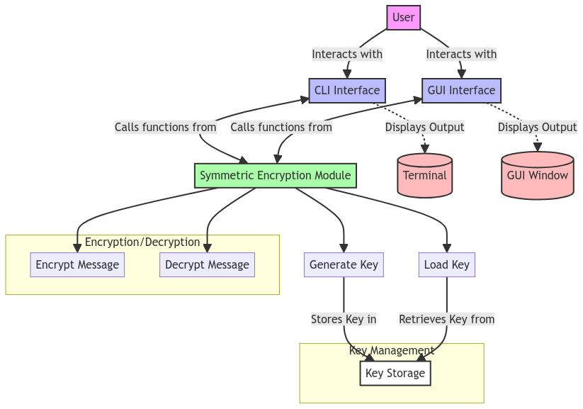
System Architecture
System Architecture

Slide 6
Proposed System
User-friendly GUI: The encryption system offers an intuitive graphical user interface (GUI) that simplifies the encryption and decryption process, making it accessible even for users without technical expertise.
Hash Libraries (SHA-256) and Fernet Cryptography: The system utilizes SHA-256 for hashing, ensuring data integrity, and Fernet cryptography for encryption, providing strong and reliable security measures to protect sensitive information.
Error Logging for Debugging and Auditing: The system incorporates robust error logging mechanisms, enabling developers to troubleshoot issues efficiently and maintain a detailed audit trail for security and compliance purposes.

Slide 7
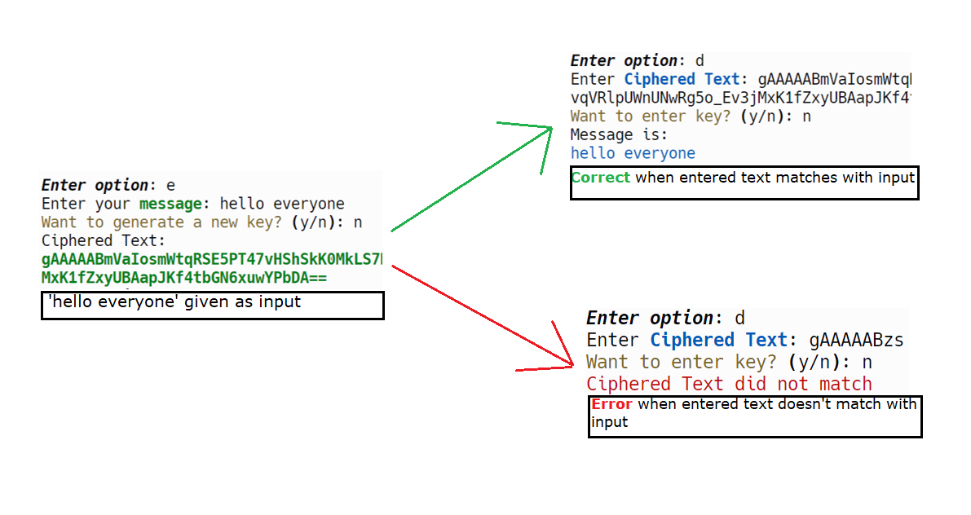
Output

Slide 8
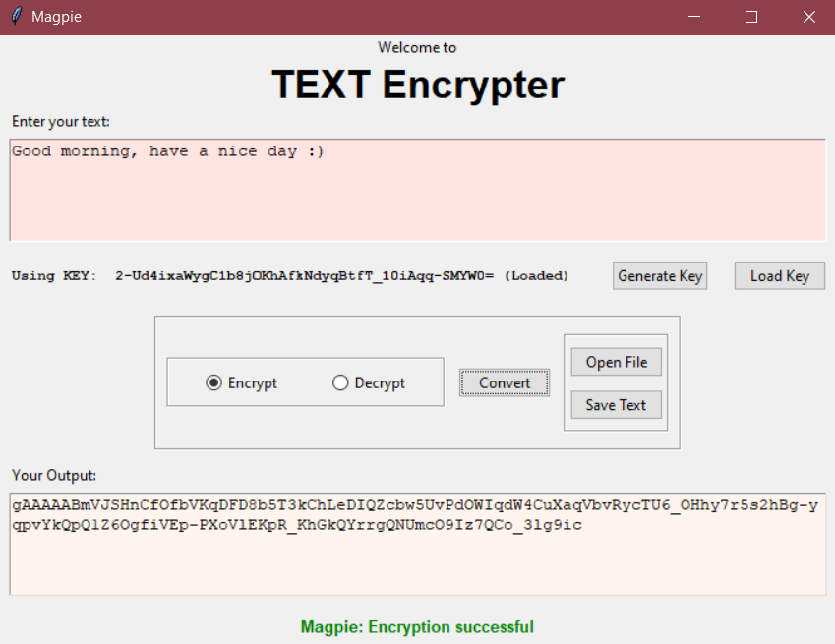

Output
Encryption using GUI (Graphical User Interface)

Slide 9
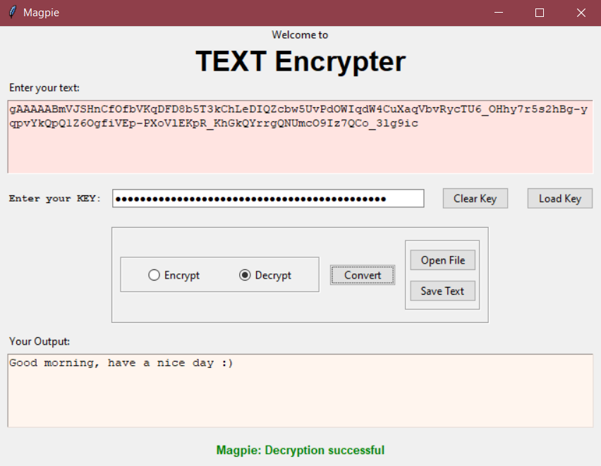
Output
Decryption using GUI (Graphical User Interface)

Slide 10
Conclusion
The Secure Message Encryption and Decryption System represents a fundamental building block for implementing secure communication and data protection in Python-based applications.
By prioritizing key management, robust encryption algorithms, and error handling mechanisms, the system offers a reliable solution for safeguarding sensitive information against unauthorized access and tampering.

Slide 11
References
Cryptography Library
Cryptography. (n.d.). cryptography.io
Python Standard Library
os Module: Python Software Foundation. (n.d.). os
binascii Module: Python Software Foundation. (n.d.). binascii
PEP 484 – Type Hints
van Rossum, G., & Lehtosalo, J. (2014). PEP 484
CLI.py
Rich Library Documentation
Python Match Statement
GUI.py
Tkinter Documentation

